Slide 1
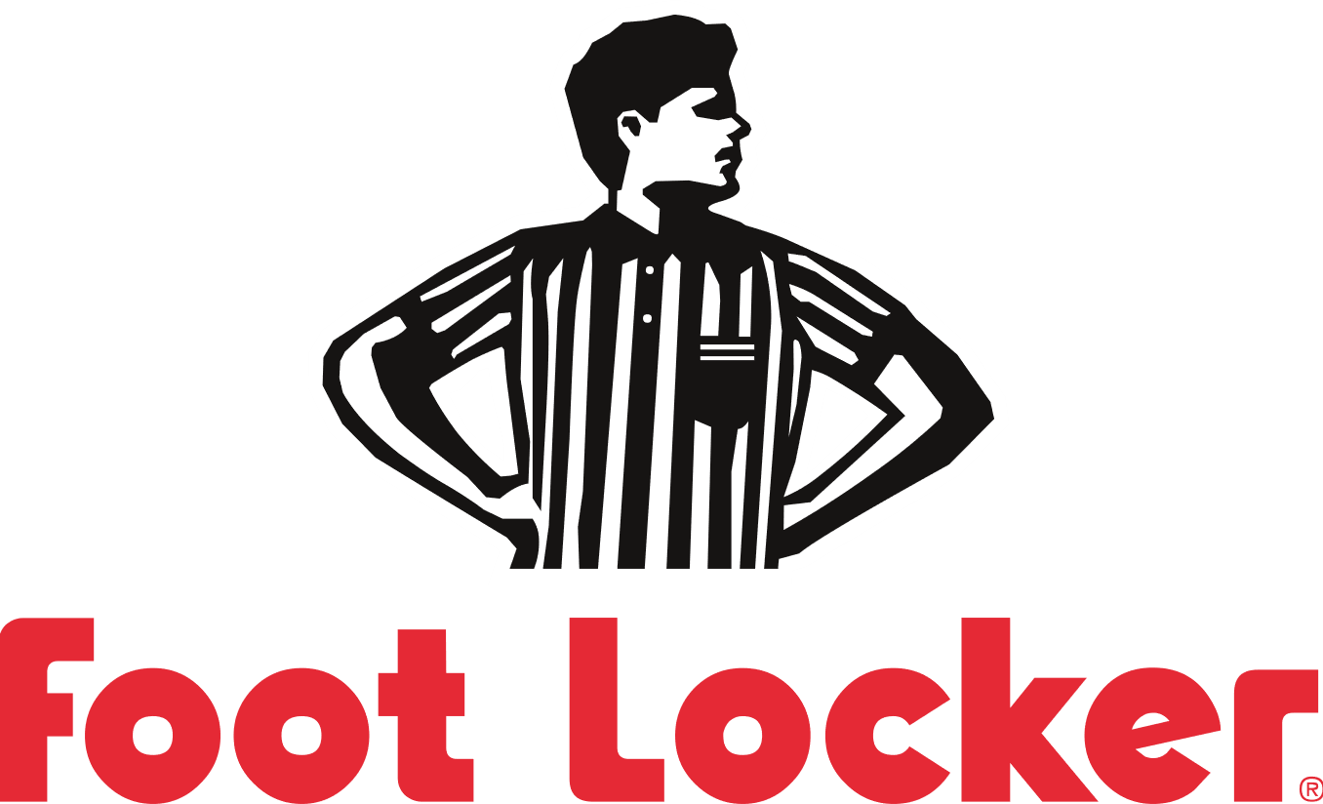

Accounting & Financial Analysis

Slide 2
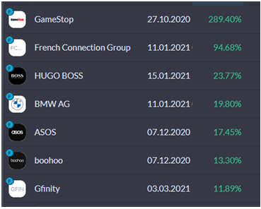
Introduction
Personal investing portfolio
Investing in undervalued stocks with good business models
Average return of 60% over past 6 months
Potential current/future investments
Foot Locker
ASOS
Dixons Carphone
BMW

Slide 3
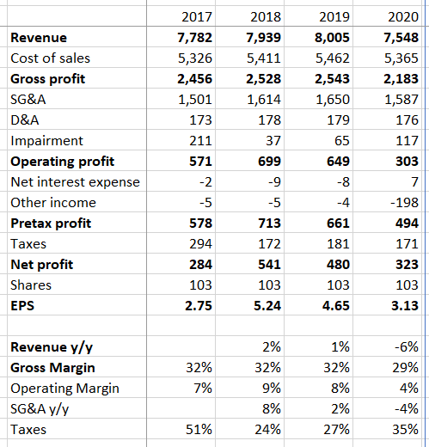
Historical performance
Modest pre-pandemic revenue growth year on year (1-2%) and consistent margins
Handled pandemic better than competitors
Only 6% revenue loss y/y compared to 20% revenue loss y/y market average
Adapted quickly to growth of e-commerce

Slide 4
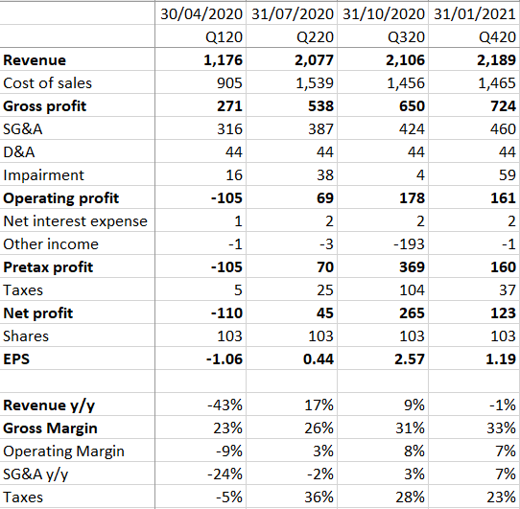
Historical performance (continued)
In-depth FY20 analysis
Q120 severely impacted by pandemic (43% drop in revenue y/y)
Q220 and Q320 revenue grew much faster than usual, due to double digit growth in e-commerce
Future revenue growth will be driven by e-commerce

Slide 5
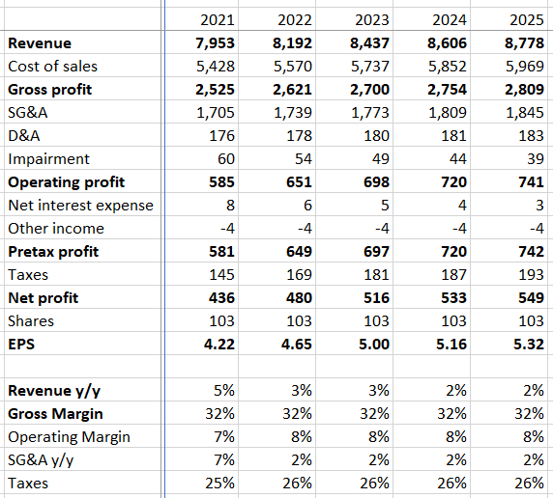
Projected performance
FY21 growth will be driven by recovery from pandemic and increase in e-commerce
Neutral forecast
Growth will continue for a couple of years, and then return to modest rates
This assumes constant margins and similar expenses growth
Potential drivers of future growth
Increase in gross margin
Reduction in operating expenses
Expansion of store network

Slide 6
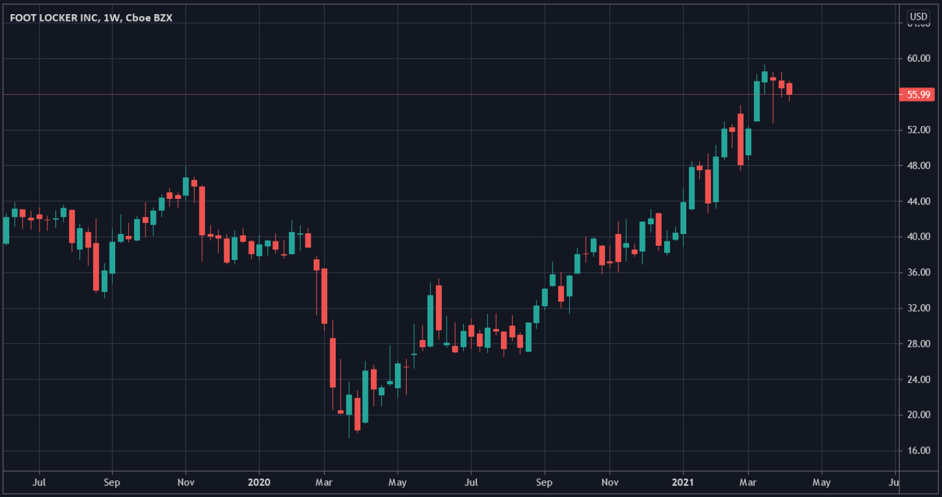
Stock price performance
50% drop in March of 2020 to $20, has since gained roughly 150% to $56

Slide 7
Key risks
Foot Locker does not recover as well as expected
Store sales may not return to pre-pandemic levels
E-commerce growth may be temporary due to pent-up demand
Margins may indefinitely stay lower
The market fails to price the stock efficiently
Foot Locker may not rise to its expected valuation
The value of the stock may stagnate or even fall before it rises

Slide 8
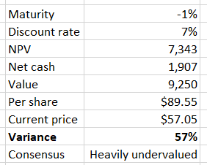
Valuation
The value of a business
This is the sum of cash that it currently holds (net cash) and the value of all future cash flows added up (NPV – net present value), discounted for inflation and the risk of the business going bankrupt (risk premium)
According to the projected performance, the value of the stock is $89, which is a 57% upside on the current price

